Slide 1
Maven Tutorial

Slide 2
Environment Setup
Set the environment variable
JAVA_HOME to C:\Program Files\Java\jdk1.7.0_60
Set the environment variables using system properties.
M2_HOME=C:\Program Files\Apache Software Foundation\apache-maven-3.3.1
M2=%M2_HOME%\bin
MAVEN_OPTS=-Xms256m -Xmx512m

Slide 3
POM(Project Object Model)
POM stands for Project Object Model. It is fundamental unit of work in Maven.
XML file (pom.xml)
resides in the base directory of the project
The POM contains information about the project and various configuration detail used by Maven to build the project(s).
project dependencies
plugins
goals
build profiles
project version
developers
mailing list

Slide 4
Minimal requirements for a POM
Project root
This is project root tag.
Model version
Model version should be 4.0.0.
groupId
This is an Id of project's group.
This is generally unique amongst an organization or a project.
For example, a banking group com.company.bank has all bank related projects.
artifactId
This is an Id of the project.
This is generally name of the project.
For example, consumer-banking.
Along with the groupId, the artifactId defines the artifact's location within the repository.
version
This is the version of the project.
Along with the groupId, It is used within an artifact's repository to separate versions from each other.
For example −
com.company.bank:consumer-banking:1.0

Slide 5
All POM files require the project element and three mandatory fields: groupId, artifactId, version.
Projects notation in repository is groupId:artifactId:version.

Slide 6
POM example
<project xmlns = http://maven.apache.org/POM/4.0.0
xmlns:xsi = http://www.w3.org/2001/XMLSchema-instance
xsi:schemaLocation
= "http://maven.apache.org/POM/4.0.0
http://maven.apache.org/xsd/maven-4.0.0.xsd">
<modelVersion>4.0.0</modelVersion>
<groupId>com.companyname.project-group</groupId>
<artifactId>project</artifactId>
<version>1.0</version>
</project>

Slide 7
Super POM
Super POM
All POMs inherit from a parent or default (despite explicitly defined or not).
This base POM is known as the Super POM, and contains values inherited by default.
effective POM
Maven use the effective POM (configuration from super pom plus project configuration) to execute relevant goal.

Slide 8
An easy way to look at the default configurations of the super POM
mvn help:effective-pom

Slide 9
Build Life Cycle
A Build Lifecycle is a well-defined sequence of phases, which define the order in which the goals are to be executed.
Phase | Handles | Description
prepare-resources | resource copying | Resource copying can be customized in this phase.
validate | Validating the information | Validates if the project is correct and if all necessary information is available.
compile | compilation | Source code compilation is done in this phase.
Test | Testing | Tests the compiled source code suitable for testing framework.
package | packaging | This phase creates the JAR/WAR package as mentioned in the packaging in POM.xml.
install | installation | This phase installs the package in local/remote maven repository.
Deploy | Deploying | Copies the final package to the remote repository.

Slide 10
There are always pre and post phases to register goals, which must run prior to, or after a particular phase.
When Maven starts building a project, it steps through a defined sequence of phases and executes goals, which are registered with each phase.
Maven has the following three standard lifecycles −
clean
default(or build)
site

Slide 11
A goal represents a specific task which contributes to the building and managing of a project.
It may be bound to zero or more build phases.
A goal not bound to any build phase could be executed outside of the build lifecycle by direct invocation.
The order of execution depends on the order in which the goal(s) and the build phase(s) are invoked.

Slide 12
For example, consider the command below.
mvn clean dependency:copy-dependencies package
The clean and package arguments are build phases while the dependency:copy-dependencies is a goal.
Here the clean phase will be executed first, followed by the dependency:copy-dependencies goal, and finally package phase will be executed.

Slide 13
Clean Lifecycle
When we execute mvn post-clean command, Maven invokes the clean lifecycle consisting of the following phases.
pre-clean
clean
post-clean
Maven clean goal (clean:clean) is bound to the clean phase in the clean lifecycle.
Its clean:cleangoal deletes the output of a build by deleting the build directory.
Thus, when mvn clean command executes, Maven deletes the build directory.

Slide 14
In the following example, We'll attach maven-antrun-plugin:run goal to the pre-clean, clean, and post-clean phases.
<project xmlns = http://maven.apache.org/POM/4.0.0
xmlns:xsi = http://www.w3.org/2001/XMLSchema-instance
xsi:schemaLocation =
"http://maven.apache.org/POM/4.0.0 http://maven.apache.org/xsd/maven-4.0.0.xsd">
<modelVersion>4.0.0</modelVersion>
<groupId>com.companyname.projectgroup</groupId>
<artifactId>project</artifactId>
<version>1.0</version>
<build>
<plugins>
<plugin>
<groupId>org.apache.maven.plugins</groupId>
<artifactId>maven-antrun-plugin</artifactId>
<version>1.1</version>

Slide 15
<executions> <execution>
<id>id.pre-clean</id>
<phase>pre-clean</phase>
<goals>
<goal>run</goal>
</goals>
<configuration>
<tasks>
<echo>pre-clean phase</echo>
</tasks>
</configuration>
</execution>
<execution>
<id>id.clean</id>
<phase>clean</phase>
<goals>
<goal>run</goal>
</goals>
<configuration>
<tasks>
<echo>clean phase</echo>
</tasks>
</configuration>
</execution>

Slide 16
<execution>
<id>id.post-clean</id>
<phase>post-clean</phase>
<goals>
<goal>run</goal>
</goals>
<configuration>
<tasks>
<echo>post-clean phase</echo>
</tasks>
</configuration>
</execution>
</executions>
</plugin>
</plugins>
</build>
</project>

Slide 17
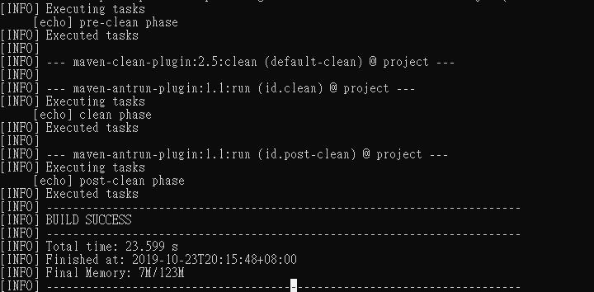
mvn post-clean

Slide 18
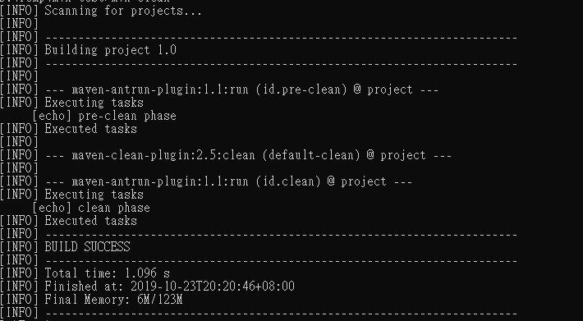
You can try tuning mvn clean command, which will display pre-clean and clean. Nothing will be executed for post-clean phase.

Slide 19
Default (or Build) Lifecycle
Sr.No. | Lifecycle Phase & Description
1 | validate Validates whether project is correct and all necessary information is available to complete the build process.
2 | initialize Initializes build state, for example set properties.
3 | generate-sources Generate any source code to be included in compilation phase.
4 | process-sources Process the source code, for example, filter any value.
5 | generate-resources Generate resources to be included in the package.
6 | process-resources Copy and process the resources into the destination directory, ready for packaging phase.

Slide 20
7 | compile Compile the source code of the project.
8 | process-classes Post-process the generated files from compilation, for example to do bytecode enhancement/optimization on Java classes.
9 | generate-test-sources Generate any test source code to be included in compilation phase.
10 | process-test-sources Process the test source code, for example, filter any values.
11 | test-compile Compile the test source code into the test destination directory.
12 | process-test-classes Process the generated files from test code file compilation.

Slide 21
13 | test Run tests using a suitable unit testing framework (Junit is one).
14 | prepare-package Perform any operations necessary to prepare a package before the actual packaging.
15 | package Take the compiled code and package it in its distributable format, such as a JAR, WAR, or EAR file.
16 | pre-integration-test Perform actions required before integration tests are executed. For example, setting up the required environment.
17 | integration-test Process and deploy the package if necessary into an environment where integration tests can be run.
18 | post-integration-test Perform actions required after integration tests have been executed. For example, cleaning up the environment.

Slide 22
19 | verify Run any check-ups to verify the package is valid and meets quality criteria.
20 | install Install the package into the local repository, which can be used as a dependency in other projects locally.
21 | deploy Copies the final package to the remote repository for sharing with other developers and projects.

Slide 23
important concepts related to Maven Lifecycles
When a phase is called via Maven command, for example mvn compile, only phases up to and including that phase will execute.
Different maven goals will be bound to different phases of Maven lifecycle depending upon the type of packaging (JAR / WAR / EAR).

Slide 24
In the following example, we will attach maven-antrun-plugin:run goal to few of the phases of Build lifecycle

Slide 25
<project xmlns = http://maven.apache.org/POM/4.0.0
xmlns:xsi = http://www.w3.org/2001/XMLSchema-instance
xsi:schemaLocation =
"http://maven.apache.org/POM/4.0.0 http://maven.apache.org/xsd/maven-4.0.0.xsd">
<modelVersion>4.0.0</modelVersion>
<groupId>com.companyname.projectgroup</groupId>
<artifactId>project</artifactId>
<version>1.0</version>
<build> <plugins> <plugin>
<groupId>org.apache.maven.plugins</groupId>
<artifactId>maven-antrun-plugin</artifactId>
<version>1.1</version>
<executions>
<execution> <id>id.validate</id>
<phase>validate</phase> <goals>
<goal>run</goal> </goals>
<configuration>
<tasks>
<echo>validate phase</echo>
</tasks>
</configuration>
</execution>
<execution> <id>id.compile</id> <phase>compile</phase>
<goals> <goal>run</goal> </goals>
<configuration>
<tasks>
<echo>compile phase</echo>
</tasks>
</configuration> </execution>

Slide 26
<execution>
<id>id.test</id>
<phase>test</phase> <goals>
<goal>run</goal>
</goals>
<configuration>
<tasks>
<echo>test phase</echo> </tasks>
</configuration> </execution>
<execution> <id>id.package</id>
<phase>package</phase>
<goals> <goal>run</goal>
</goals> <configuration>
<tasks> <echo>package phase</echo> </tasks>
</configuration> </execution>
<execution> <id>id.deploy</id>
<phase>deploy</phase>
<goals> <goal>run</goal>
</goals> <configuration>
<tasks> <echo>deploy phase</echo>
</tasks> </configuration>
</execution> </executions> </plugin>
</plugins>
</build>
</project>

Slide 27
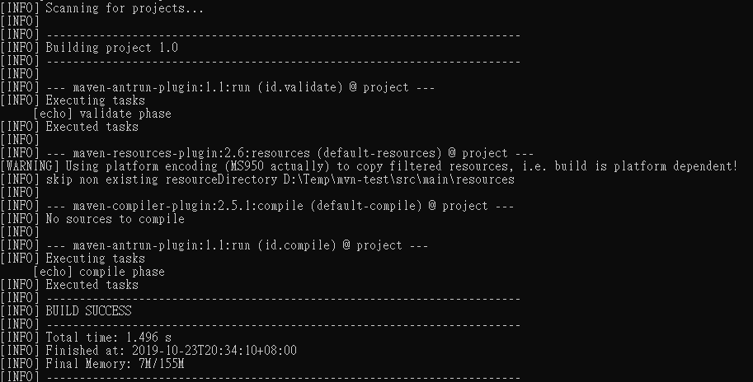

Slide 28
Site Lifecycle
Maven Site plugin is generally used to create fresh documentation to create reports, deploy site, etc. It has the following phases −
pre-site
site
post-site
site-deploy

Slide 29
Maven - Build Profiles
A Build profile is a set of configuration values, which can be used to set or override default values of Maven build.
Using a build profile, you can customize build for different environments such as Production v/s Development environments.
Profiles are specified in pom.xml file using its activeProfiles/profiles elements and are triggered in variety of ways.

Slide 30
Types of Build Profile
Type | Where it is defined
Per Project | Defined in the project POM file, pom.xml
Per User | Defined in Maven settings xml file (%USER_HOME%/.m2/settings.xml)
Global | Defined in Maven global settings xml file (%M2_HOME%/conf/settings.xml)

Slide 31
Profile Activation
Explicitly using command console input.
Through maven settings.
Based on environment variables (User/System variables).
OS Settings (for example, Windows family).
Present/missing files.

Slide 32
Explicit Profile Activation
execute the following mvn command. Pass the profile name as argument using -P option.
C:\MVN\project>mvn test -Ptest

Slide 33
Profile Activation via Maven Settings
Open Maven settings.xml file available in %USER_HOME%/.m2
<settings xmlns = "http://maven.apache.org/POM/4.0.0"
xmlns:xsi = "http://www.w3.org/2001/XMLSchema-instance"
xsi:schemaLocation="http://maven.apache.org/POM/4.0.0
http://maven.apache.org/xsd/settings-1.0.0.xsd">
<activeProfiles>
<activeProfile>test</activeProfile>
</activeProfiles>
</settings>

Slide 34
Profile Activation via Environment Variables
update the test profile mentioned in pom.xml
The test profile will trigger when the system property "env" is specified with the value "test". Create an environment variable "env" and set its value as "test".
<profile>
<id>test</id>
<activation>
<property>
<name>env</name>
<value>test</value>
</property>
</activation>
</profile>

Slide 35
Profile Activation via Operating System
Activation element to include os detail as shown below. This test profile will trigger when the system is windows XP.
<profile>
<id>test</id>
<activation>
<os>
<name>Windows XP</name>
<family>Windows</family>
<arch>x86</arch>
<version>5.1.2600</version>
</os>
</activation>
</profile>

Slide 36
Profile Activation via Present/Missing File
The test profile will trigger when target/generated-sources/axistools/wsdl2java/com/companyname/group is missing.
<profile>
<id>test</id>
<activation>
<file>
<missing>target/generated-sources/axistools/wsdl2java/com/companyname/group</missing>
</file>
</activation>
</profile>

Slide 37
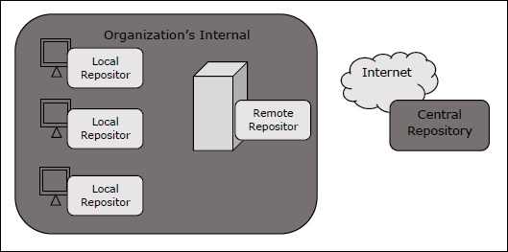
Maven - Repositories
a repository is a directory where all the project jars, library jar, plugins or any other project specific artifacts are stored and can be used by Maven easily.
Maven repository are of three types.
local
central
remote

Slide 38
Local Repository
Maven local repository is a folder location on your machine.
It gets created when you run any maven command for the first time.
Maven local repository keeps your project's all dependencies (library jars, plugin jars etc.).
When you run a Maven build, then Maven automatically downloads all the dependency jars into the local repository.
by default, %USER_HOME% directory.

Slide 39
To override the default location, mention another path in Maven settings.xml file available at %M2_HOME%\conf directory.
<settings xmlns = http://maven.apache.org/SETTINGS/1.0.0
xmlns:xsi = http://www.w3.org/2001/XMLSchema-instance
xsi:schemaLocation = "http://maven.apache.org/SETTINGS/1.0.0
http://maven.apache.org/xsd/settings-1.0.0.xsd">
<localRepository>C:/MyLocalRepository</localRepository>
</settings>

Slide 40
Central Repository
Maven central repository is repository provided by Maven community.
When Maven does not find any dependency in local repository, it starts searching in central repository
− https://repo1.maven.org/maven2/
To browse the content of central maven repository,
− https://search.maven.org/#browse

Slide 41
Remote Repository
Remote Repository, which is developer's own custom repository containing required libraries or other project jars.
Maven will download dependency (if not available in central repository) from Remote Repositories mentioned in the pom.xml.
<project xmlns = "http://maven.apache.org/POM/4.0.0"
xmlns:xsi = http://www.w3.org/2001/XMLSchema-instance
xsi:schemaLocation = "http://maven.apache.org/POM/4.0.0
http://maven.apache.org/xsd/maven-4.0.0.xsd">
<modelVersion>4.0.0</modelVersion>
<groupId>com.companyname.projectgroup</groupId>
<artifactId>project</artifactId>
<version>1.0</version>
<repositories>
<repository>
<id>companyname.lib1</id>
<url>http://download.companyname.org/maven2/lib1</url>
</repository>
</repositories>
</project>

Slide 42
Maven Dependency Search Sequence
1 − Search dependency in local repository
2 − Search dependency in central repository
3 − Search dependency in remote repository If a remote repository has been mentioned

Slide 44
Reference
https://www.tutorialspoint.com/maven/index.htm

